Slide 1
Deforestation detection
Radu-Mihai Sîrbu, Babes-Bolyai University Cluj-Napoca

Slide 2
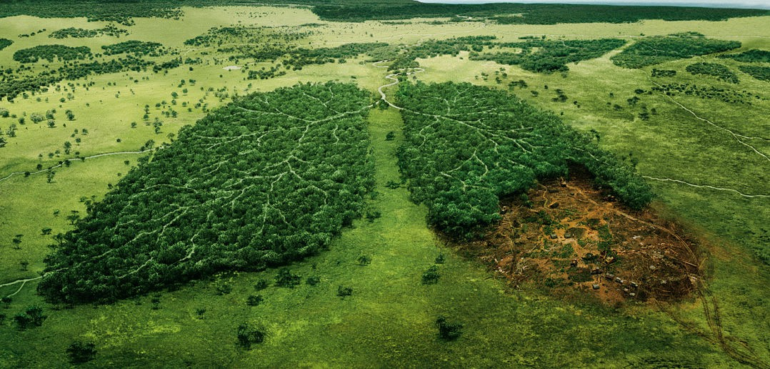
Deforestation as a problem
Throughout history and into modern times, forests have been razed to make space for agriculture and animal grazing, and to obtain wood for fuel, manufacturing, and construction.
Deforestation has greatly altered landscapes around the world.
Deforestation has greatly altered landscapes around the world. With fewer trees around to take in the carbon dioxide, this greenhouse gas accumulates in the atmosphere and accelerates global warming.

Slide 3
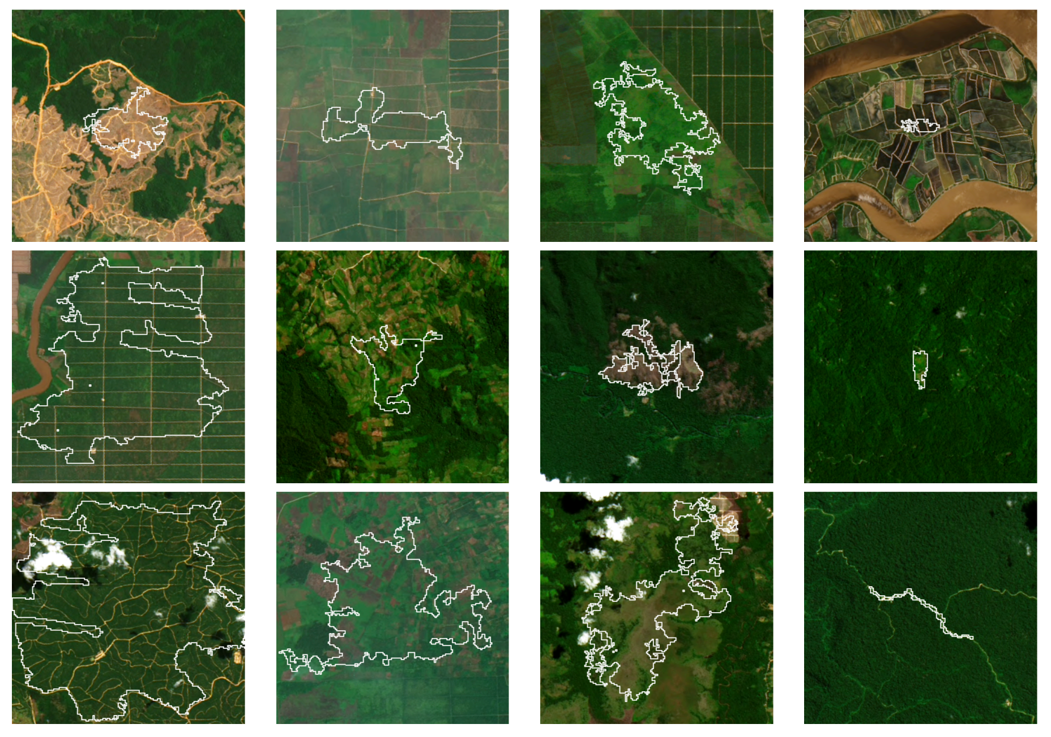
Project purpose – detect deforestation from satellite images

Slide 4
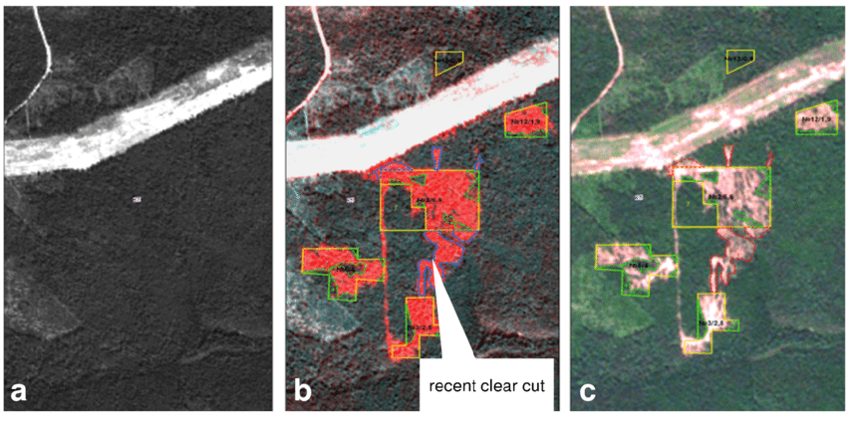
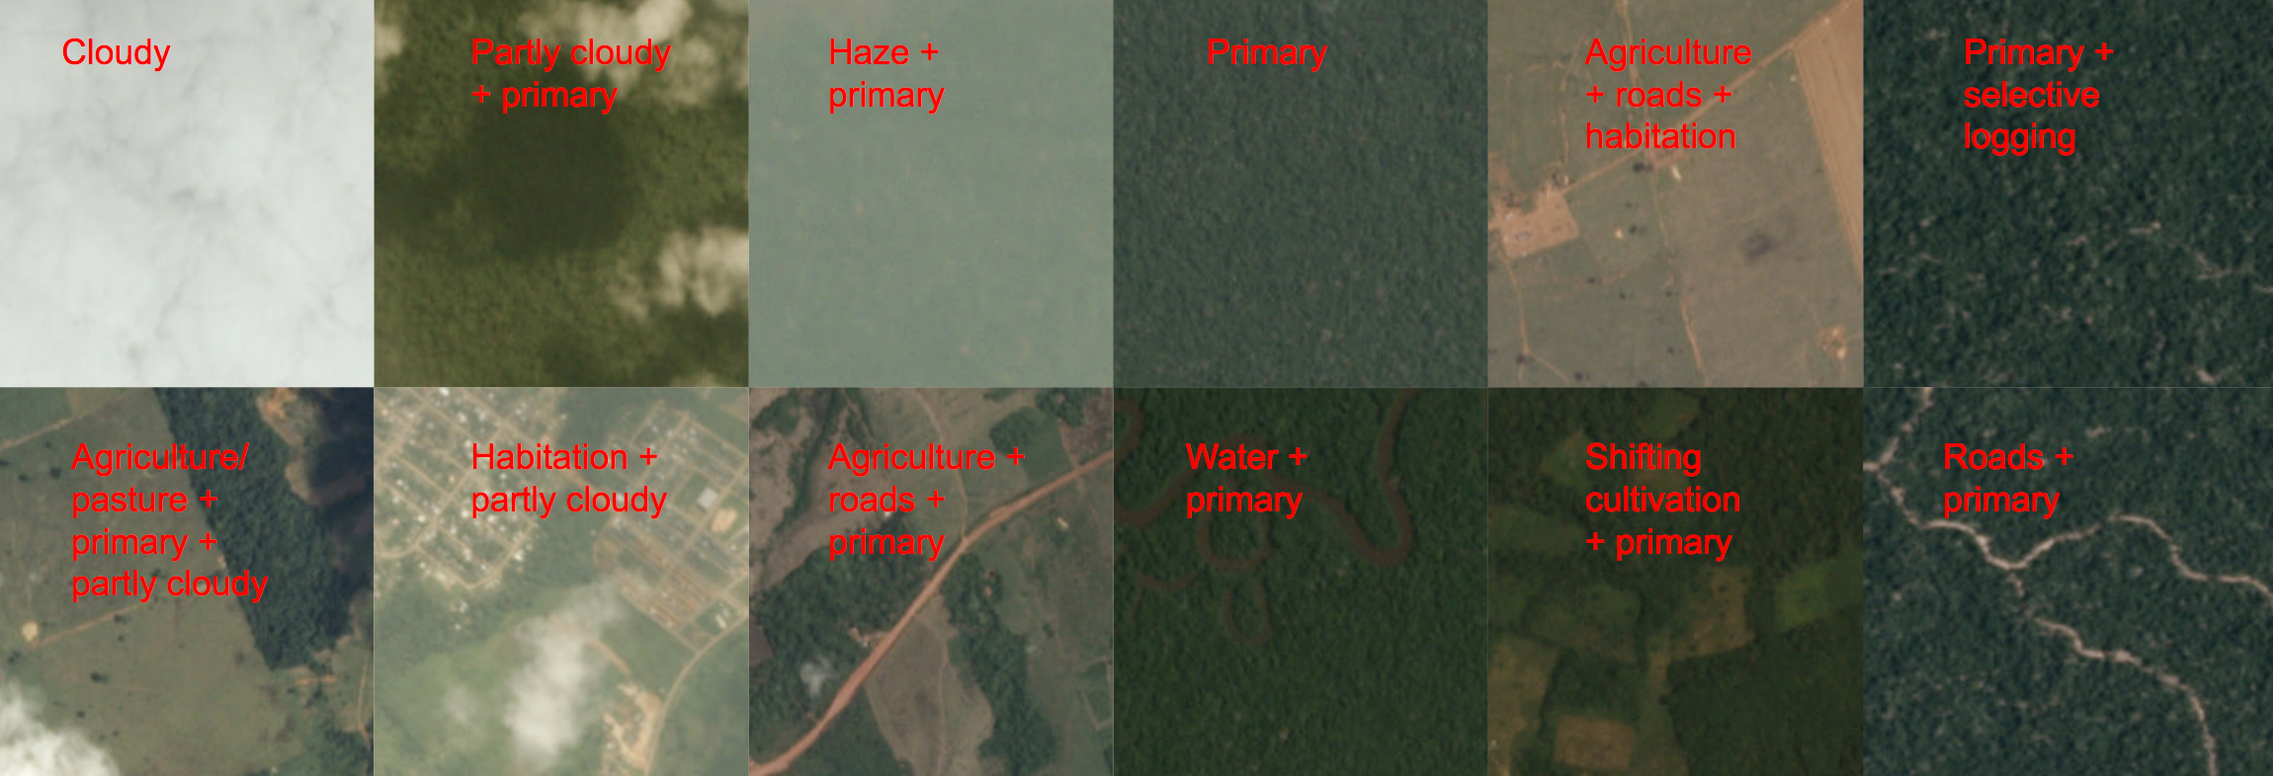
Chosen method of detection
Amazon Rainforest Satellite Images Dataset

Slide 5
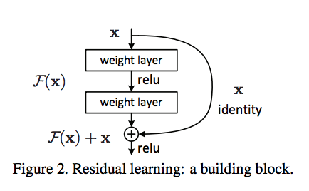
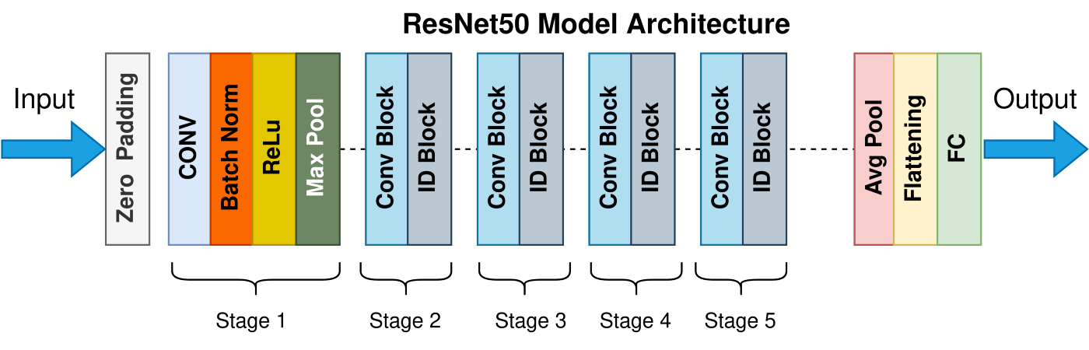
Approach
Deforestation related labels: [agriculture, artisanal mine, convetional mine, cultivation, road, logging, burns]

Slide 6
Approach
128
Dropout
256
Dropout
17
ResNet50
FLATTEN

Slide 7
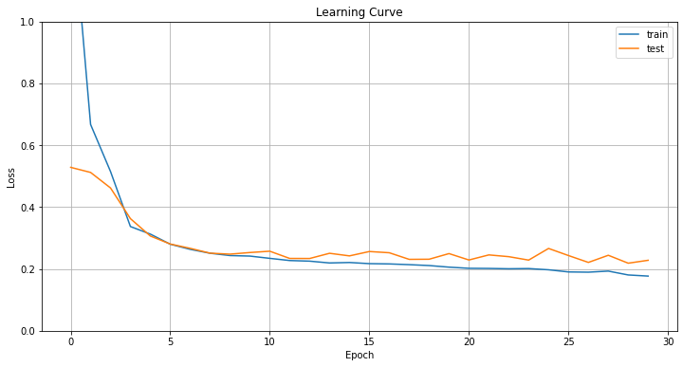
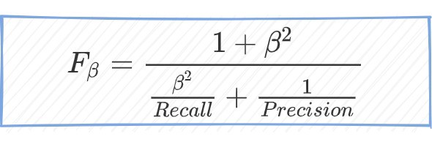
Results
F_beta Score: 0.85

Slide 8
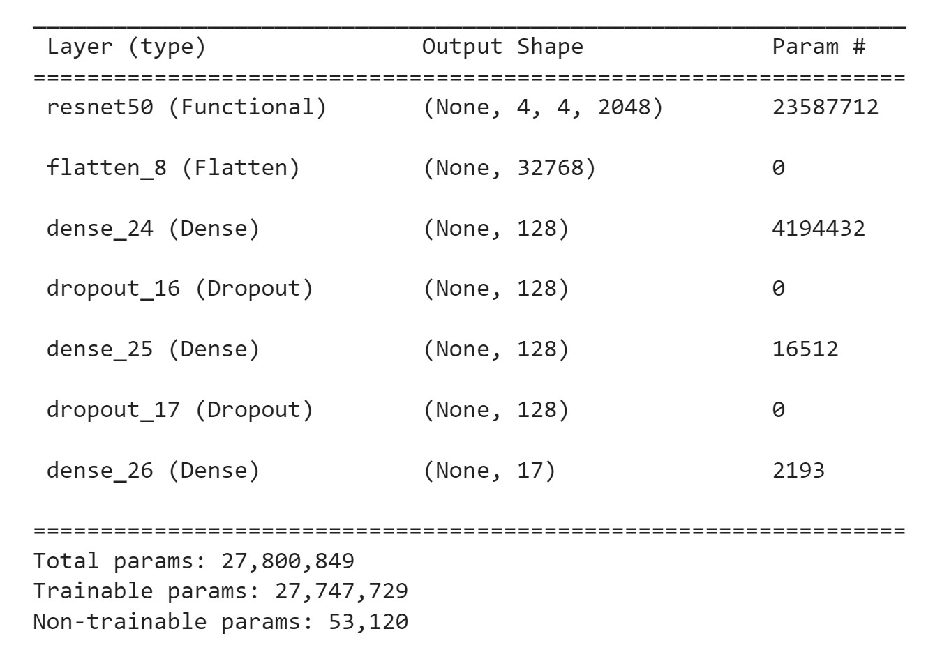
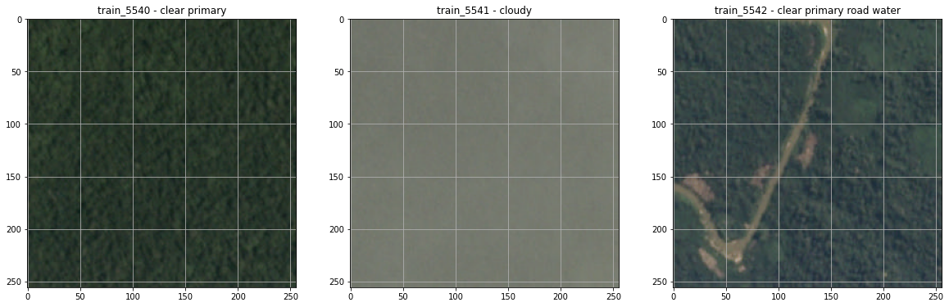
Deforestation detection – Radu-Mihai Sîrbu
Motivation
Deforestation has become a major problem and needs to be tackled as soon as possible.
There are more and more satellites orbiting the planet and their images can prove to be really useful in this matter.
Proposed solution
Define a deep learning model that is able to identify deforestation related events from satellite images based on the ResNet50 architecture.
Label each image with some predefined deforestation related tags to help with detection.
Dataset
Train the proposed model using the Amazon Rainforest Satellite Images dataset. It contains over 40k images, labeled into 17 categories.
Experiments
A few more layers were added on top of the ResNet50 architecture: flatten, 2 fully connected layers with the ReLu activation function, 2 droput layers and one last fully connected layer for the 17 class labels.
The highest F_beta score achieved was 0.85 when training over 50 epochs with a batch size of 128.
Project source
https://github.com/radufx/deforestation-detection

